Slide 1


Unit – 1.1 Number Theory
BTech & BSc (H)-CS $→$ 3rd Semester
Discrete Mathematics (2301HS301)
Prof. Vasudev Barjadiya
Department of Humanities & Science
vasudev.barjadiya@darshan.ac.in
901 64 27 400

Slide 2

Looping
Topics of Unit 1.1
Principles of Mathematical Induction
Congruence Relation
Application of Congruence Relation

Slide 3

Looping
Outline of Unit 1.1
Principles of Mathematical Induction
Congruence Relation
Properties of Congruence
Application of Congruence Relation
Encrypting and Decrypting a Message using Caesar Cipher Method
Encrypting and Decrypting a Message using RSA Cryptosystem

Slide 4
Method 1
Principle of Mathematical Induction

Slide 5
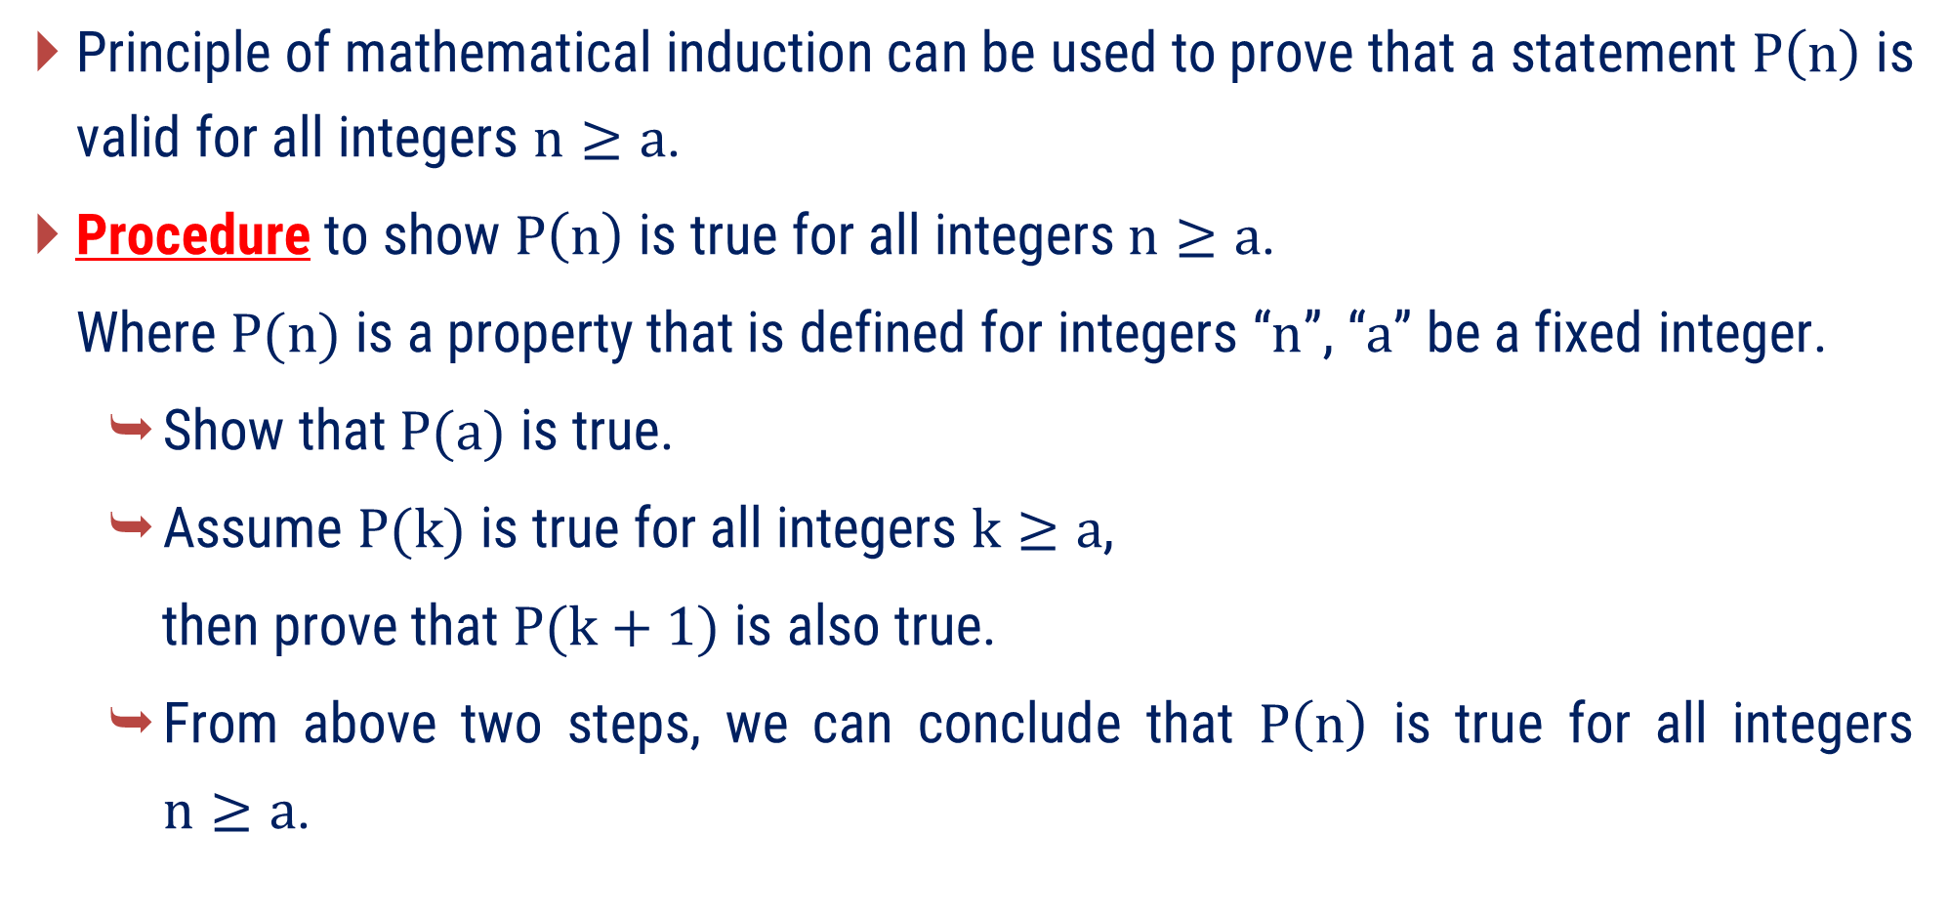
Principle of Mathematical Induction
Principle of mathematical induction can be used to prove that a statement $P\left(n\right)$ is valid for all integers $n≥a$.
Procedure to show $P\left(n\right)$ is true for all integers$n≥a$.
Where $P(n)$ is a property that is defined for integers “$n$”, “$a$” be a fixed integer.
Show that $P(a)$ is true.
Assume $P(k)$ is true for all integers $k≥a$,
then prove that $P(k+1)$ is also true.
From above two steps, we can conclude that $P\left(n\right)$ is true for all integers $n≥a$.

Slide 6
Examples of Method 1
Principle of Mathematical Induction

Slide 7

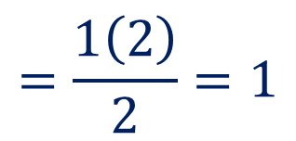
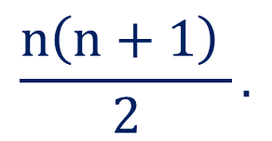


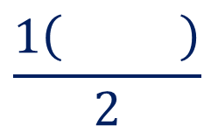




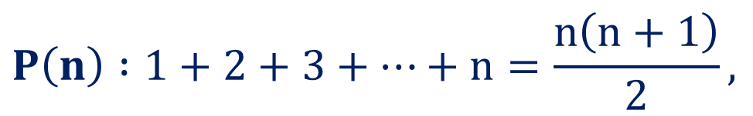

Method 1 ⇝ Example 1
Question:
Prove that proposition $P$, the sum of the first $n$ positive integers is
$$\frac{n\left(n+1\right) }{2}.$$
$$P\left(n\right) :1+2+3+…+n=\frac{n\left(n+1\right)}{2},$$
Solution:
Let,
$$n∈ℕ$$
For
$$n=1$$
Here, LHS$=$RHS
LHS $=$
$$1$$
Hence, $P\left(1\right)$ is true.
$$1+1$$
$$\frac{1\left(1+1\right)}{2}$$
$$=\frac{1\left(2\right)}{2}=1$$
RHS $=$

Slide 8



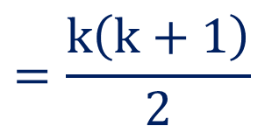

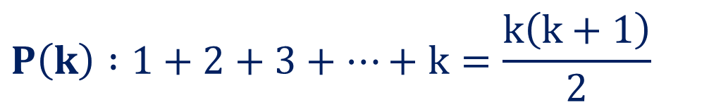
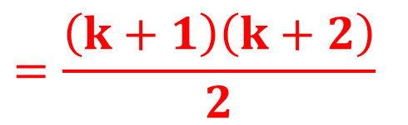
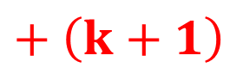
Method 1 ⇝ Example 1 (Continue)
Now,
$$\frac{n\left(n+1\right) }{2}.$$
Assume that $P\left(k\right)$ is true for all positive integer $k≥1.$
$$P\left(k\right) :1+2+3+…+k=\frac{k\left(k+1\right)}{2}$$
i.e.,
To prove:
$$=\frac{\left(k+1\right)\left(k+2\right)}{2}$$
$$P\left(k+1\right) :$$
$$1+2+3+…+k$$
$$+ \left(k+1\right)$$
LHS
$$=1+2+3+…+k+\left(k+1\right)$$
$$=\frac{k\left(k+1\right)}{2}$$
$$+ \left(k+1\right)$$

Slide 9
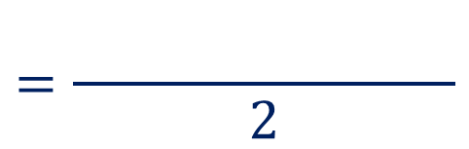
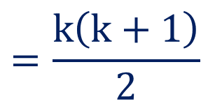
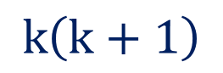



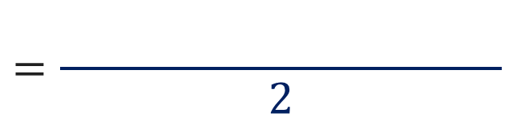
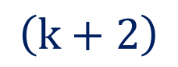


Method 1 ⇝ Example 1 (Continue)
$$=\frac{k\left(k+1\right)}{2}$$
LHS
$$+ \left(k+1\right)$$
$$\frac{n\left(n+1\right) }{2}.$$
$$=\frac{ n\left(n+1\right)+2\left(n+1\right) }{2}$$
$$k\left(k+1\right)$$
$$+ 2\left(k+1\right)$$
$$\left(k+1\right)$$
$$\left(k+2\right)$$
$$=\frac{ n\left(n+1\right)+2 }{2}$$
$=$ RHS
So, $P\left(k+1\right)$ is true.
Hence, given proposition is proved.

Slide 10
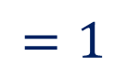
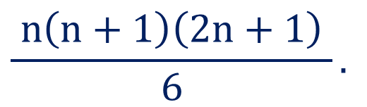

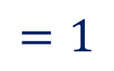



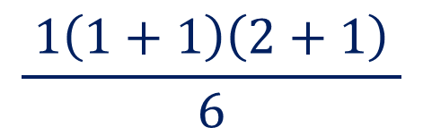

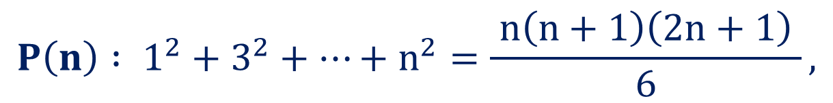



Method 1 ⇝ Example 2
Question:
Prove that proposition $P$, the sum of the squares of the first $n$ positive
integers is
$$\frac{ n\left(n+1\right)\left(2n+1\right) }{6}.$$
$$P\left(n\right) : 1^{2}+3^{2}+…+n^{2}=\frac{ n\left(n+1\right)\left(2n+1\right) }{6},$$
Solution:
Let,
$$n∈ℕ$$
For
$$n=1$$
Here, LHS$=$RHS
LHS $=$
$$1^{2}$$
$$=1$$
Hence, $P\left(1\right)$ is true.
$$\frac{ 1\left(1+1\right)\left(2+1\right) }{6}$$
RHS $=$
$$=1$$

Slide 11
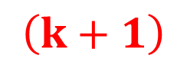
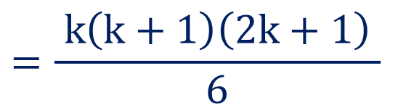
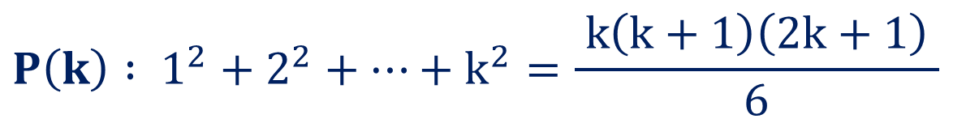
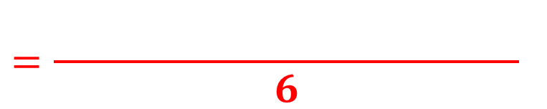
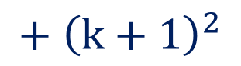
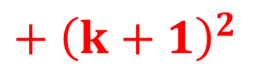
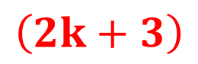

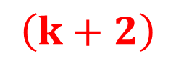

Method 1 ⇝ Example 2 (Continue)
Now,
Assume that $P\left(k\right)$ is true for all positive integer $k≥1$
$$P\left(k\right) : 1^{2}+2^{2}+…+k^{2}=\frac{ k\left(k+1\right)\left(2k+1\right) }{6}$$
i.e.,
To prove:
$$=\frac{ n\left(n+ 1\right) }{6}$$
$$\left(k+1\right)$$
$$\left(k+2\right)$$
$$\left(2k+3\right)$$
$$P\left(k+1\right) :$$
$$1^{2}+2^{2}+…+k^{2}$$
$$+ {\left(k+1\right)}^{2}$$
LHS
$$=1^{2}+2^{2}+3^{2}+…+k^{2}+ {\left(k+1\right)}^{2}$$
$$=\frac{ k\left(k+1\right)\left(2k+1\right) }{6}$$
$$+ {\left(k+1\right)}^{2}$$

Slide 12

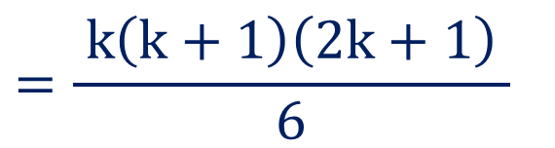
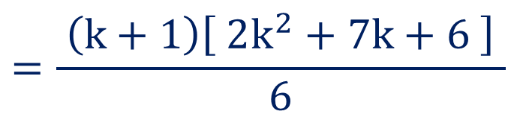
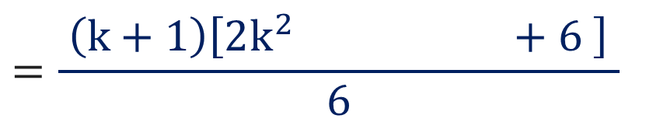
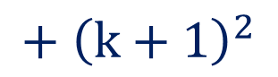
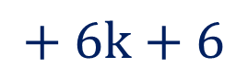
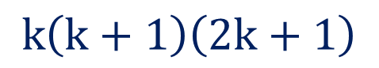
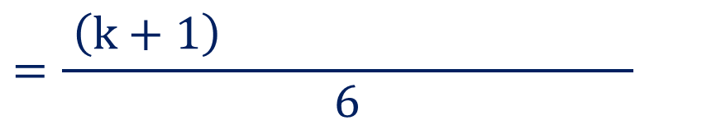
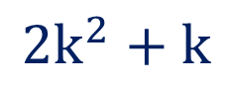
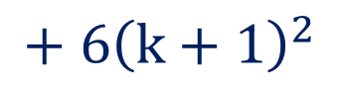

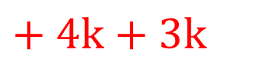
Method 1 ⇝ Example 2 (Continue)
$$=\frac{ k\left(k+1\right)\left(2k+1\right) }{6}$$
LHS
$$+ {\left(k+1\right)}^{2}$$
$$k\left(k+1\right)\left(2k+1\right)$$
$$+ {6\left(k+1\right)}^{2}$$
$$=\frac{ n\left(n+1\right)+2\left(n+1\right) }{6}$$
$$2k^{2}+k$$
$$+ 6k+6$$
$$=\frac{ \left(k+1\right) }{6}$$
$$=\frac{ \left(k+1\right)\left[ 2k^{2}+7k\text{ + 6} \right] }{6}$$
$$+ 4k+3k$$
$$=\frac{ \left(k+1\right)\left[2k^{2}+4n+3n\text{ + 6} \right] }{6}$$

Slide 13
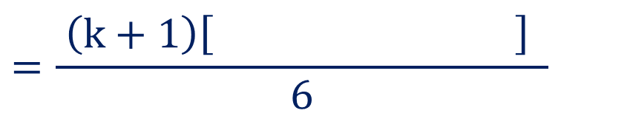
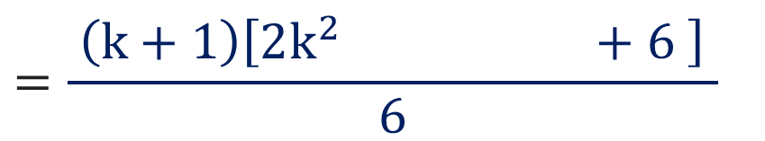


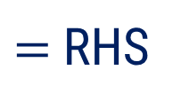

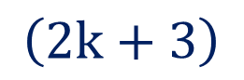
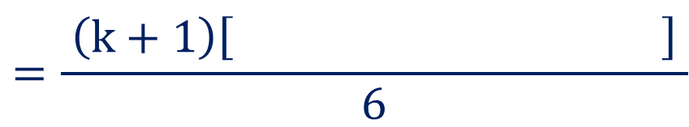


Method 1 ⇝ Example 2 (Continue)
$$+ 4k+3k$$
$$=\frac{ \left(k+1\right)\left[2k^{2}+4n+3n\text{ + 6} \right] }{6}$$
$$=\frac{ \left(k+1\right)\left[ 2n^{2}+4n+3n\text{ + 6} \right] }{6}$$
$$2k\left(k+2\right)$$
$$+ 3\left(k+2\right)$$
$$=\frac{ \left(k+1\right)\left[ 2n^{2}+4n+3 \right] }{6}$$
$$\left(k+2\right)$$
$$\left(2k+3\right)$$
$=$ RHS
So, $P\left(k+1\right)$ is true.
Hence proved.

Slide 14



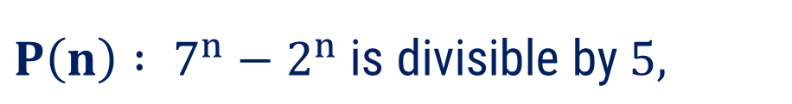


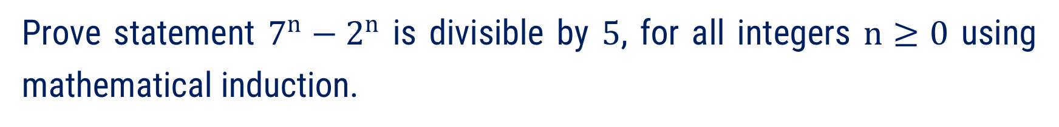


Method 1 ⇝ Example 3
Question:
Prove statement $7^{n}−2^{n}$ is divisible by $5$, for all integers $n≥0$ using mathematical induction.
$$P\left(n\right) : 7^{n}−2^{n} \text{is} \text{divisible} \text{by} 5,$$
Solution:
Let,
$$n≥0$$
For
$$n=0$$
$$7^{0}−2^{0}$$
$$=1−1$$
$$= 0$$
, which is divisible by $5$.
So, $P(0)$ is true.

Slide 15





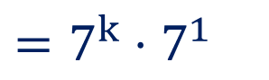

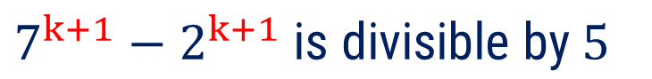



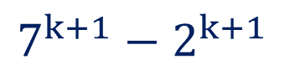
Method 1 ⇝ Example 3 (Continue)
Now,
Assume that $P\left(k\right)$ is true for all positive integer $k≥0$
i.e.,
$$P\left(k\right) :7^{k}−2^{k} \text{is} \text{divisible} \text{by} 5$$
To prove:
$$P\left(k+1\right) :$$
$$7^{k+1}−2^{k+1} \text{is} \text{divisible} \text{by} 5$$
$$7^{k+1}−2^{k+1}$$
$$=7^{k}⋅7^{1}$$
$$− 2^{k}⋅2^{1}$$
$$=7^{k}⋅$$
$$\left(5+2\right)$$
$$− 2^{k}⋅2$$
$$=7^{k}⋅5+ 7^{k}⋅2− 2^{k}⋅2$$
$$+ 7^{k}⋅2$$
$$− 2^{k}⋅2$$

Slide 16
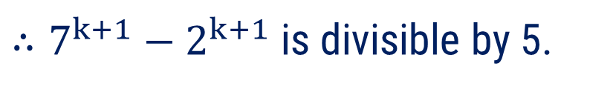

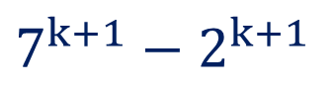
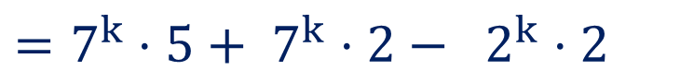





Method 1 ⇝ Example 3 (Continue)
$$7^{k+1}−2^{k+1}$$
$$=7^{k}⋅5+ 7^{k}⋅2− 2^{k}⋅2$$
$$=7^{k}⋅5$$
$$\left( 7^{k}−2^{k} \right)$$
$$+ 2$$
We known that $7^{k}⋅5$ is divisible by 5.
Already, $7^{k}−2^{k}$ is divisible by 5.
(By assumption)
$∴7^{k+1}−2^{k+1}$ is divisible by 5.
So, $P\left(k+1\right)$ is true.
Hence, given property is proved.

Slide 17












Method 1 ⇝ Example 4
Question:
Use mathematical induction to prove that $2n+1<2^{n}$, for all integers $n≥3$.
$$P\left(n\right) :2n+1<2^{n},$$
Solution:
Let,
$$n≥3$$
For
$$n=3$$
LHS $=$
$$2\left(3\right)+1$$
$$=7$$
RHS $=$
$$2^{3}$$
$$=8$$
Clearly, LHS $<$ RHS
So, $P(3)$ is true.

Slide 18










Method 1 ⇝ Example 4 (Continue)
Now,
Assume that $P\left(k\right)$ is true for all positive integer $k≥3$
i.e.,
$$P\left(k\right) :2k+1<2^{k}$$
To prove:
$$P\left(k+1\right) :$$
$$2\left(k+1\right)+1$$
$$< 2^{k+1}$$
$$2\left(k+1\right)+1$$
$$=2k+ 2$$
$$+ 1$$
$$=2k+ 1$$
$$+ 2$$
$$< 2^{k}+ 2$$
$$+ 2$$

Slide 19








Method 1 ⇝ Example 4 (Continue)
$$2\left(k+1\right)+1$$
$$< 2^{k}+ 2$$
$$< 2^{k}$$
$$⋅ 2$$
We known that $a+2<a⋅2$ for $a>2$
and for $k≥3, 2^{k}>2$.
$$= 2^{k+1}$$
$$∴2\left(k+1\right)+1< 2^{k+1}$$
So, $P\left(k+1\right)$ is true.
Hence, given proposition is proved.

Slide 20
Method 2
Congruence Relation

Slide 21


















Modulo OR Modulus OR Mod
The modulo (or "modulus" or "mod") is the remainder after dividing one number by another.
Let $a$ and $b$ be two integers, then $a \left(mod b\right)$ gives remainder after dividing $a$ by $b$.
For Example:
$12 \left(mod 7\right)$
$−11 \left(mod 3\right)$
$$=5$$
$$1$$
$$−3$$
$$−4$$
$$7$$
$$12$$
$$3$$
$$−11$$
$$3$$
$$−11$$
$$=1$$
$$7$$
$$−9$$
$$−12$$
$$5$$
$$−2$$
$$1$$

Slide 22

Properties of Modulo
$\left(a+b\right) \left(mod m\right) =\left[\left[a \left(mod m\right)+b \left(mod m\right)\right]\right] \left(mod m\right)$
$\left(a−b\right) \left(mod m\right)=\left[\left[a \left(mod m\right)−b \left(mod m\right)\right]\right] \left(mod m\right)$
$\left(a×b\right) \left(mod m\right)=\left[\left[a \left(mod m\right)×b \left(mod m\right)\right]\right] \left(mod m\right)$
$\left(a^{b}\right) \left(mod m\right)=\left[\left[{\left(a \left(mod m\right)\right)}^{b}\right]\right] \left(mod m\right)$

Slide 23

Congruence Relation
Let $a$ and $b$ are integers and $m$ be a positive integer.
If $m$ divides$a−b$, then $m$ is known as modulus and we can say that “$a$” is congruent to “$b$” modulo $m$.
It is denoted by $a≡b \left(mod m\right)$ or $a≡b \left(modulo m\right)$ and read as “a is congruent to b modulo m”.
When $m$ does not divide $a−b$ we say that “$a$” is incongruent to “$b$” modulo $m$.
It is denoted by $a≢b \left(mod m\right)$ and read as “a is incongruent to b modulo m”.

Slide 24



Congruence Relation
For Example:
$87≡23 \left(mod 4\right)$
$27≢8 \left(mod 9\right)$
as 4 divides $87−23=64$
as 9 does not divide $27−8=19$

Slide 25

Basic Properties of Congruence
Let $m>1$ be fixed and $a, b, c, d$ be arbitrary integers. Then the following properties hold:
If $a≡b \left(mod m\right)$, then there exist "$k$" such that $a=k⋅m+b, 0≤b<m$.
$a≡b \left(mod m\right)$ means that $a$ and $b$ leave the same nonnegative remainder when divided by $m$.
i.e., $a=k_{1}⋅m+r$ and $b=k_{2}⋅m+r$
$a≡a \left(mod m\right)$
If $a≡b \left(mod m\right)$, then $b≡a \left(mod m\right)$.

Slide 26

Basic Properties of Congruence
Let $m>1$ be fixed and $a, b, c, d$ be arbitrary integers. Then the following properties hold:
If $a≡b \left(mod m\right)$ and $b≡c \left(mod m\right)$, then $a≡c \left(mod m\right).$
If $a≡c \left(mod m\right)$ and $b≡d \left(mod m\right)$, then
$a+b≡c+d \left(mod m\right)$ and
$a b≡c d \left(mod m\right)$.
If $a≡b \left(mod m\right)$, then
$a+c≡b+c \left(mod m\right)$ and
$ac≡bc \left(mod m\right)$.

Slide 27
Examples of Method 2
Congruence Relation

Slide 28













Method 2 ⇝ Example 1
Question:
Which of the following is true?
$$\left(1\right) −446≡−278 \left(mod 7\right)$$
$$(2) 383≡126 \left(mod 15\right)$$
Solution:
$$\left(1\right) −446≡−278 \left(mod 7\right)$$
$$\left(2\right) 383≡126\left(mod 15\right)$$
Here, $−446−$
$$\left(−278\right)$$
$$=−168$$
Here, $383−$
$$126$$
$$=257$$
Since, $−168$ is divisible by $7$.
Since, $257$ is not divisible by $15$.
$−446≡−278 \left(mod 7\right)$ is true.
$383≡126\left(mod 15\right)$ is false.

Slide 29












Method 2 ⇝ Example 2
Question:
Find the smallest non-negative integer which is congruent modulo $m=8$ to each of the following numbers:
$$(1) 379$$
$$(2) −578$$
Solution:
$$\left(1\right) 379$$
$$47$$
By using division algorithm,
$$8$$
$$379$$
$$376$$
$$379$$
$$=47⋅8$$
$$+ 3$$
$$3$$
Since, $0<3<8$.
Hence, $3$ is required smallest number.

Slide 30
















Method 2 ⇝ Example 2 (Continue)
$$\left(2\right) −578$$
$$−72$$
By using division algorithm,
$$8$$
$$−578$$
$$−576$$
$$−578$$
$$=\left(−73\right)⋅8$$
$$+ 6$$
is valid as $0<6<8$.
$$−2$$
So, $6$ is required smallest number.
$$−73$$
$$8$$
$$−578$$
$$−584$$
$$6$$

Slide 31
Method 3
Application of Congruence Relation
(Encrypting and Decrypting a Message using Caesar Cipher Method)

Slide 32
Cryptography
The word cryptography is derived from the Greek kryptos, meaning “hidden” and graphein meaning “to write”.
Cryptography is the science of secret writing with the goal of hiding the meaning of a message.
Basic Terminologies:
Plaintext
Ciphertext
Encryption
Decryption
: The original information that needs to be protected.
: The transformed, encrypted form of the plaintext.
: The process of converting plaintext into ciphertext.
: The process of converting ciphertext back into plaintext.

Slide 33

Caesar Cipher
One of the earliest cryptographic systems was used by the great Roman emperor Julius Caesar around 50 B.C.
In which each letter of the alphabet is replaced by the letter that occurs three places down the alphabet.
i.e., $A$ would be replaced by $D$, $B$ by $E$ and so forth.

Slide 34

Steps to Encrypt a Message Using Caesar Cipher Method
Step 1:
Assign unique integer $p$ to each alphabet of given plaintext.
For assigning an integer use the following table.
A | B | C | D | E | F | G | H | I | J | K | L | M
0 | 1 | 2 | 3 | 4 | 5 | 6 | 7 | 8 | 9 | 10 | 11 | 12
N | O | P | Q | R | S | T | U | V | W | X | Y | Z
13 | 14 | 15 | 16 | 17 | 18 | 19 | 20 | 21 | 22 | 23 | 24 | 25

Slide 35

Steps to Encrypt a Message Using Caesar Cipher Method
Step 2:
Encrypt each integer $p$ to an integer $c$ by following congruence relation.
$$c≡\left(p+3\right) \left(mod 26\right)$$
Here, $p+3$ represents that each letter of given plaintext will be shifted forward by 3 places.
Step 3:
Translate back this integer $c$ to alphabet to write a ciphertext.

Slide 36
Example
Encrypt a message “$ENEMY$” using Caesar cipher.
Step 1: Assigning unique integer $p$ to each alphabet of given plaintext.
Plaintext | E | N | E | M | Y
p
4
13
4
12
24
A | B | C | D | E | F | G | H | I | J | K | L | M
0 | 1 | 2 | 3 | 4 | 5 | 6 | 7 | 8 | 9 | 10 | 11 | 12
N | O | P | Q | R | S | T | U | V | W | X | Y | Z
13 | 14 | 15 | 16 | 17 | 18 | 19 | 20 | 21 | 22 | 23 | 24 | 25

Slide 37













Example
Step 2: Encryption by using $c≡\left(p+3\right) \left(mod 26\right)$.
$$\left(4+3\right) \left(mod 26\right)$$
$$=7 \left(mod 26\right)$$
$$=7$$
Plaintext | E | N | E | M | Y
$$\left(13+3\right) \left(mod 26\right)$$
$$=16 \left(mod 26\right)$$
$$=16$$
p
4
13
4
12
24
$$\left(12+3\right) \left(mod 26\right)$$
$$=15 \left(mod 26\right)$$
$$=15$$
c
7
16
7
15
1
$$\left(24+3\right) \left(mod 26\right)$$
$$=27 \left(mod 26\right)$$
$$=\left(26⋅1+1\right) \left(mod 26\right)$$
$$=1$$

Slide 38

Example
Step 3: Translating this integer 𝐜 to alphabet to write a ciphertext.
c
7
16
7
15
1
Ciphertext
H
Q
H
P
B
Hence, encrypted message is “$HQHPB$”.
A | B | C | D | E | F | G | H | I | J | K | L | M
0 | 1 | 2 | 3 | 4 | 5 | 6 | 7 | 8 | 9 | 10 | 11 | 12
N | O | P | Q | R | S | T | U | V | W | X | Y | Z
13 | 14 | 15 | 16 | 17 | 18 | 19 | 20 | 21 | 22 | 23 | 24 | 25

Slide 39

Steps to Decrypt a Message Using Caesar Cipher Method
Step 1:
Assign unique integer $c$ to each alphabet of given ciphertext.
Step 2:
Decrypt each integer $c$ to an integer $p$ by following congruence relation.
$$p≡\left(c−3\right) \left(mod 26\right)$$
Step 3:
Translate back this integer $p$ to alphabet to write a plaintext.

Slide 40

Example
Decrypt a message “$CHEUD$” using Caesar cipher.
Step 1: Assigning unique integer $c$ to each alphabet of given ciphertext.
Ciphertext | C | H | E | U | D
c
2
7
4
20
3
A | B | C | D | E | F | G | H | I | J | K | L | M
0 | 1 | 2 | 3 | 4 | 5 | 6 | 7 | 8 | 9 | 10 | 11 | 12
N | O | P | Q | R | S | T | U | V | W | X | Y | Z
13 | 14 | 15 | 16 | 17 | 18 | 19 | 20 | 21 | 22 | 23 | 24 | 25

Slide 41

















Example
Step 2: Decryption by using $p≡\left(c−3\right) \left(mod 26\right)$.
$$\left(\text{2}−3\right) \left(mod 26\right)$$
$$=−1 \left(mod 26\right)$$
$$=\left(−1+26\right) \left(mod 26\right)$$
$$=25\left(mod 26\right)$$
$$=25$$
Ciphertext | C | H | E | U | D
$$\left(\text{7}−3\right) \left(mod 26\right)$$
$$=4\left(mod 26\right)$$
$$=4$$
c
2
7
4
20
3
$$\left(\text{4}−3\right) \left(mod 26\right)$$
$$=1\left(mod 26\right)$$
$$=1$$
p
25
4
1
17
0
$$\left(\text{20}−3\right) \left(mod 26\right)$$
$$=17\left(mod 26\right)$$
$$=17$$
$$\left(\text{3}−3\right) \left(mod 26\right)$$
$$=0\left(mod 26\right)$$
$$=0$$

Slide 42

Example
Step 3: Translating this integer $p$ to alphabet to write a plaintext.
p
25
4
1
17
0
Plaintext
Z
E
B
R
A
Hence, decrypted message is “$ZEBRA$”.
A | B | C | D | E | F | G | H | I | J | K | L | M
0 | 1 | 2 | 3 | 4 | 5 | 6 | 7 | 8 | 9 | 10 | 11 | 12
N | O | P | Q | R | S | T | U | V | W | X | Y | Z
13 | 14 | 15 | 16 | 17 | 18 | 19 | 20 | 21 | 22 | 23 | 24 | 25

Slide 43

Shift Cipher
We simply shift every plaintext letter by a ﬁxed number of positions say $k$ in the alphabet.
To encrypt or decrypt a message, relation $c≡\left(p+k\right) \left(mod 26\right)$or $p≡\left(c−k\right) \left(mod 26\right)$ are used, where $k$ is known as key and it is always a positive integer from 1 to 25.
Note that, shift cipher with a key value of $k=3$ it is known as “Caesar Cipher”.

Slide 44
Examples of Method 3
Encrypting and Decrypting a Message with Caesar Cipher

Slide 45

Method 3 ⇝ Example 1
Question:
Convert given plaintext “$YOU ARE GENIUS$” into ciphertext by using key value $k=4$.
Solution:
Step 1: Assigning unique integer $p$ to each alphabet of given plaintext.
Plaintext | Y | O | U | A | R | E | G | E | N | I | U | S
p
24
14
20
0
17
4
6
4
13
8
20
18
A | B | C | D | E | F | G | H | I | J | K | L | M
0 | 1 | 2 | 3 | 4 | 5 | 6 | 7 | 8 | 9 | 10 | 11 | 12
N | O | P | Q | R | S | T | U | V | W | X | Y | Z
13 | 14 | 15 | 16 | 17 | 18 | 19 | 20 | 21 | 22 | 23 | 24 | 25

Slide 46

































Method 3 ⇝ Example 1 (Continue)
Step 2: Encryption by using $c≡\left(p+4\right) \left(mod 26\right)$
p | $$c≡(p+4) (mod 26)$$
Plaintext | Y | O | U | A | R | E | G | E | N | I | U | S
p | $$c≡(p+4) (mod 26)$$
24
$$c≡ \left(24+4\right) \left(mod 26\right)$$
$$=2$$
p
4
$$c≡\left(4+4\right) \left(mod 26\right)$$
$$=8$$
24
14
20
0
17
4
6
4
13
8
20
18
14
$$c≡\left(14+4\right) \left(mod 26\right)$$
$$=18$$
13
$$c≡\left(13+4\right) \left(mod 26\right)$$
$$=17$$
c
2
18
24
4
21
8
10
8
17
12
24
22
20
$$c≡\left(20+4\right) \left(mod 26\right)$$
$$=24$$
8
$$c≡\left(8+4\right) \left(mod 26\right)$$
$$=12$$
0
$$c≡\left(0+4\right) \left(mod 26\right)$$
$$=4$$
$$\left(24+4\right) \left(mod 26\right)$$
$$=28 \left(mod 26\right)$$
$$=\left(26⋅1+2\right) \left(mod 26\right)$$
$$=2$$
20
$$c≡\left(20+4\right) \left(mod 26\right)$$
$$=24$$
17
$$c≡\left(17+4\right) \left(mod 26\right)$$
$$=21$$
$$\left(14+4\right) \left(mod 26\right)$$
$$=18 \left(mod 26\right)$$
$$=18$$
18
$$c≡\left(18+4\right) \left(mod 26\right)$$
$$=22$$
4
$$c≡\left(4+4\right) \left(mod 26\right)$$
$$=8$$
6
$$c≡\left(6+4\right) \left(mod 26\right)$$
$$=10$$
Proceeding in this manner we get rest of encryptions.

Slide 47
Method 3 ⇝ Example 1 (Continue)
Step 3: Translating this integer $c$ to alphabet to write a ciphertext.
c
2
18
24
4
21
8
10
8
17
12
24
22
Ciphertext
C
S
Y
E
V
I
K
I
R
M
Y
W
Hence, encrypted message is “$CSY EVI KIRMYW$”.
A | B | C | D | E | F | G | H | I | J | K | L | M
0 | 1 | 2 | 3 | 4 | 5 | 6 | 7 | 8 | 9 | 10 | 11 | 12
N | O | P | Q | R | S | T | U | V | W | X | Y | Z
13 | 14 | 15 | 16 | 17 | 18 | 19 | 20 | 21 | 22 | 23 | 24 | 25

Slide 48

Method 3 ⇝ Example 2
Question:
Convert given ciphertext “$ANPNSLX$” into plaintext by using key value $k=5$.
Solution:
Step 1: Assigning unique integer $c$ to each alphabet of given plaintext.
Ciphertext | A | N | P | N | S | L | X
c
0
13
15
13
18
11
23
A | B | C | D | E | F | G | H | I | J | K | L | M
0 | 1 | 2 | 3 | 4 | 5 | 6 | 7 | 8 | 9 | 10 | 11 | 12
N | O | P | Q | R | S | T | U | V | W | X | Y | Z
13 | 14 | 15 | 16 | 17 | 18 | 19 | 20 | 21 | 22 | 23 | 24 | 25

Slide 49























Method 3 ⇝ Example 2 (Continue)
Step 2: Decryption by using $p≡\left(c−5\right) \left(mod 26\right)$
c | $$p≡(c−5) (mod 26)$$
Ciphertext | A | N | P | N | S | L | X
17
$$p≡\left(17−5\right) \left(mod 26\right)$$
$$=12$$
c
0
13
15
13
18
11
23
13
$$p≡\left(\text{13}−5\right) \left(mod 26\right)$$
$$=8$$
p
21
8
10
8
13
6
18
22
$$p≡\left(22−5\right) \left(mod 26\right)$$
$$=17$$
5
$$p≡\left(5−5\right) \left(mod 26\right)$$
$$=0$$
$$\left(0−5\right) \left(mod 26\right)$$
$$=−5 \left(mod 26\right)$$
7
$$p≡\left(7−5\right) \left(mod 26\right)$$
$$=2$$
$$=\left(−5+26\right) \left(mod 26\right)$$
$$=21 \left(mod 26\right)$$
$$=21$$
16
$$p≡\left(16−5\right) \left(mod 26\right)$$
$$=11$$
$$\left(13−5\right) \left(mod 26\right)$$
$$=8 \left(mod 26\right)$$
$$=8$$
9
$$p≡\left(9−5\right) \left(mod 26\right)$$
$$=4$$
Proceeding in this manner we get rest of decryptions.

Slide 50

Method 3 ⇝ Example 2 (Continue)
Step 3: Translating this integer $p$ to alphabet to write a plaintext.
p
21
8
10
8
13
6
18
Plaintext
V
I
K
I
N
G
S
Hence, decrypted message is “$VIKINGS$”.
A | B | C | D | E | F | G | H | I | J | K | L | M
0 | 1 | 2 | 3 | 4 | 5 | 6 | 7 | 8 | 9 | 10 | 11 | 12
N | O | P | Q | R | S | T | U | V | W | X | Y | Z
13 | 14 | 15 | 16 | 17 | 18 | 19 | 20 | 21 | 22 | 23 | 24 | 25

Slide 51
Method 4
Application of Congruence Relation
(Encrypting and Decrypting a Message using RSA Cryptosystem)

Slide 52
RSA Cryptosystem
In 1976, three researchers at the Massachusetts Institute of Technology Ronald Rivest, Adi Shamir and Leonard Adleman introduced the RSA system.
The RSA cryptosystem is an example of a “public key” system.
This means that everyone can know the encryption key, but it is computationally infeasible for an unauthorized person to deduce the corresponding decryption key.

Slide 53

RSA Key Generation
Step 1:
Choose two large primes $p$ and $q$.
Step 2:
Compute $n=p⋅q$.
Step 3:
Compute $Φ\left(n\right)=\left(p−1\right)\left(q−1\right)$.
(Will be used as modulus)

Slide 54

RSA Key Generation
Step 4:
Select the public exponent $e$ such that
$e∈\left\{ 1, 2, 3, …, Φ\left(n\right)−1 \right\}$ and
$\gcd\left(e,Φ\left(n\right)\right)=1$.
Public Key:
$$k_{pub}=\left(n, e\right)$$

Slide 55

RSA Key Generation
Step 5:
Compute the private key $d$such that
$d⋅e≡1 \left(mod Φ\left(n\right)\right)$ OR $d≡e^{−1} \left(mod Φ\left(n\right)\right).$
Note that here $d∈\left\{ 1, 2, 3, …, Φ\left(n\right)−1 \right\}$
Private Key:
$$k_{pr}=\left(n, d\right)$$

Slide 56

RSA Encryption & Decryption
RSA Encryption:
Given the public key $k_{pub}=\left(n, e\right)$ and the plaintext $m$, then ciphertext $c$ is
$$c≡m^{e} \left(mod n\right).$$
RSA Decryption:
Given the private key $k_{pr}=\left(n, d\right)$ and the ciphertext $c$, then plaintext $m$is
$$m≡c^{d} \left(mod n\right).$$

Slide 57







Example
Encrypt a message $m=12$ using RSA cryptosystem with public key $\left(35, 11\right)$.
Given message is $m=12$ and public key is $k_{pub}=\left(35, 11\right).$
So, $n=35$ and $e=11$.
Now,
$$c≡m^{e} \left(mod n\right)$$
$$⇒$$
$$c≡{12}^{11} \left(mod 35\right)$$
$$⇒$$
$$c≡\left(12×{12}^{2}×{12}^{8}\right) \left(mod 35\right)$$
$$c≡\left[\left[\left(12 \left(mod 35\right)\right)×\left({12}^{2} \left(mod 35\right)\right)×\left({12}^{8} \left(mod 35\right)\right)\right]\right] \left(mod 35\right)$$
$$⇒$$
$$c≡\left[\left[\left(12 \left(mod 35\right)\right)×\left({12}^{2} \left(mod 35\right)\right)×\left({12}^{8} \left(mod 35\right)\right)\right]\right] \left(mod 35\right)$$
$$\left(12 \left(mod 35\right)\right)×\left({12}^{2} \left(mod 35\right)\right)×\left({12}^{8} \left(mod 35\right)\right)$$

Slide 58


























Example
$$c≡\left[\left[\left(12 \left(mod 35\right)\right)×\left({12}^{2} \left(mod 35\right)\right)×\left({12}^{8} \left(mod 35\right)\right)\right]\right] \left(mod 35\right)$$
Here,
So,
$$c≡\left( 12×4×11 \right) \left(mod 35\right)$$
$$12$$
$$×$$
$$12 \left(mod 35\right)$$
$$=$$
$$12$$
$$4$$
$$×$$
$$11$$
$$c≡528 \left(mod 35\right)$$
$${12}^{2} \left(mod 35\right)$$
$$=$$
$$144 \left(mod 35\right)$$
$$c≡3 \left(mod 35\right)$$
$$=$$
$$4$$
$${12}^{8} \left(mod 35\right)$$
$$=$$
$${\left({12}^{2}\right)}^{4} \left(mod 35\right)$$
Hence, encrypted message is
$$=$$
$${\left({12}^{2} \left(mod 35\right)\right)}^{4} \left(mod 35\right)$$
$$c=3$$
$$=$$
${\left(4\right)}^{4} \left(mod 35\right)$
$$=$$
$$256 \left(mod 35\right)$$
$$=$$
$$11$$

Slide 59
Examples of Method 4
Encrypting and Decrypting a Message using RSA Cryptosystem

Slide 60














Method 4 ⇝ Example 1
Question:
Encrypt a message $m=9$ using RSA algorithm with $p=5, q=11,$ $e=3$.
Solution:
Given message is $m=9$ and $p=5, q=11, e=3.$
$$⇒$$
$$n=5⋅11$$
$$=55$$
So,
public key is
$$k_{pub}=\left(n,e\right)=\left(55, 3\right)$$
Now,
$$c≡m^{e} \left(mod n\right)$$
$$⇒$$
$$c≡9^{3} \left(mod 55\right)$$
$$⇒$$
$$c≡\left( 9× \right) \left(mod 55\right)$$
$$729$$
Hence, encrypted message is
$$⇒$$
$$c≡14$$
$$c=14.$$

Slide 61














Method 4 ⇝ Example 2
Question:
Decrypt a message $c=4$ using RSA cryptosystem with value $p=3, q=11, e=3$.
Solution:
Given message is $c=4$ and $p=3, q=11, e=3.$
$$⇒$$
$$n=3⋅11$$
$$=33$$
To decrypt given message first we need to compute $d$ such that
$d⋅e≡1 \left(mod Φ\left(n\right)\right)$.
Here,
$$Φ\left(n\right)$$
$$=$$
$$\left(p−1\right)$$
$$\left(q−1\right)$$
$$=$$
$$2$$
$$⋅10$$
$$=$$
$$20$$

Slide 62











Method 4 ⇝ Example 2 (Continue)
Now,
$d⋅e≡1 \left(mod Φ\left(n\right)\right)$.
$$⇒$$
$d⋅3≡1 \left(mod 20\right)$.
So, there exist an integer $t$ such that
$$3d=20t+1$$
$$d=\frac{20t+1}{3}$$
$$t=0$$
$$0$$
$$d=\frac{20\left( \right)+1}{3}$$
$$=$$
$$0.33$$
$$∉\left\{ 1, 2, 3, …, Φ\left(n\right)−1 \right\}$$

Slide 63













Method 4 ⇝ Example 2 (Continue)
$$t=1$$
$$1$$
$$d=\frac{20\left( \right)+1}{3}$$
$$\frac{ 21 }{3}$$
$$=$$
$$=$$
$$7$$
$$∈\left\{ 1, 2, 3, …, Φ\left(n\right)−1 \right\}$$
So, $d=7$
$$⇒$$
Private key
$$k_{pr}$$
$$=\left(n,d\right)$$
$$=\left(33, 7\right)$$

Slide 64













Method 4 ⇝ Example 2 (Continue)
$$k_{pr}$$
$$=\left(n,d\right)$$
$$=\left(33, 7\right)$$
Now,
$$m≡c^{d} \left(mod n\right)$$
$c=4$
$$⇒$$
$$m≡4^{7} \left(mod 33\right)$$
$$m≡\left( \right) \left(mod 33\right)$$
$$⇒$$
$$16,384$$
$$⇒$$
$m≡16 \left(mod 33\right)$
Hence, encrypted message is
$$m=16.$$

Slide 65


















Method 4 ⇝ Example 3
Question:
Decrypt a message $c=19$ using RSA cryptosystem with value $p=11, q=17, d=23$.
Solution:
Given message is $c=19$ and $p=11, q=17, d=23.$
$$⇒$$
$$n=11⋅17$$
$$=187$$
$$⇒$$
Private key
$$k_{pr}$$
$$=\left(n,d\right)$$
$$=\left(187, 23\right)$$
Now,
$$m≡c^{d} \left(mod n\right)$$
$$⇒$$
$$m≡{19}^{23} \left(mod 187\right)$$
$$⇒$$
$${19}^{7}$$
$$×$$
$${19}^{7}$$
$$×$$
$${19}^{7}$$
$$×$$
$${19}^{2}$$
$$m≡\left( 19 × {19}^{2} × {19}^{4} × {19}^{16} \right) \left(mod 187\right)$$

Slide 66










Method 4 ⇝ Example 3 (Continue)
$$m≡ \left[\left[\left({19}^{7} \left(mod 187\right)\right)×\left({19}^{7} \left(mod 187\right)\right)×\left({19}^{7} \left(mod 187\right)\right) \right]\right.$$
$$\left.\left[×\left({19}^{2} \left(mod 187\right)\right)\right]\right] \left(mod 187\right)$$
Here,
$${19}^{7} \left(mod 187\right)$$
$$=$$
$$89,38,71,739 \left(mod 187\right)$$
$$=$$
$$145$$
$${19}^{2} \left(mod 187\right)$$
$$=$$
$$361 \left(mod 187\right)$$
$$=$$
$$174$$

Slide 67
















Method 4 ⇝ Example 3 (Continue)
$$m≡ \left[\left[\left({19}^{7} \left(mod 187\right)\right)×\left({19}^{7} \left(mod 187\right)\right)×\left({19}^{7} \left(mod 187\right)\right) \right]\right.$$
$$\left.\left[×\left({19}^{2} \left(mod 187\right)\right)\right]\right] \left(mod 187\right)$$
$$m≡\left( \right) \left(mod 187\right)$$
$$145$$
$$×$$
$$145$$
$$×$$
$$145$$
$$×$$
$$174$$
$$m≡53,04,60,750 \left(mod 187\right)$$
$$m≡94 \left(mod 187\right)$$
$${19}^{7} \left(mod 187\right)$$
$$=$$
$$145$$
Hence, decrypted message is
$${19}^{2} \left(mod 187\right)$$
$$=$$
$$174$$
$$m=94.$$

